Slide 1
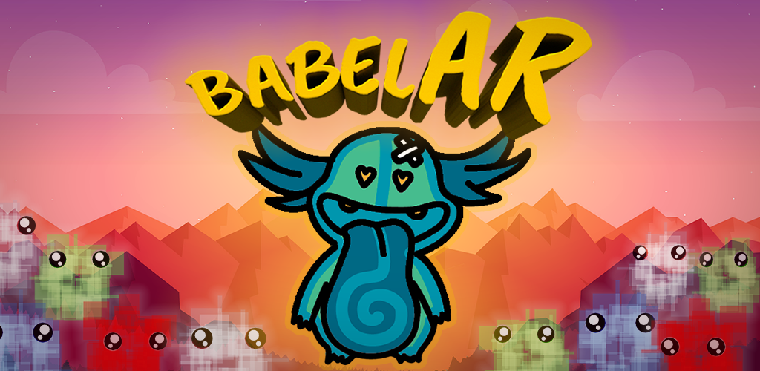

Slide 2
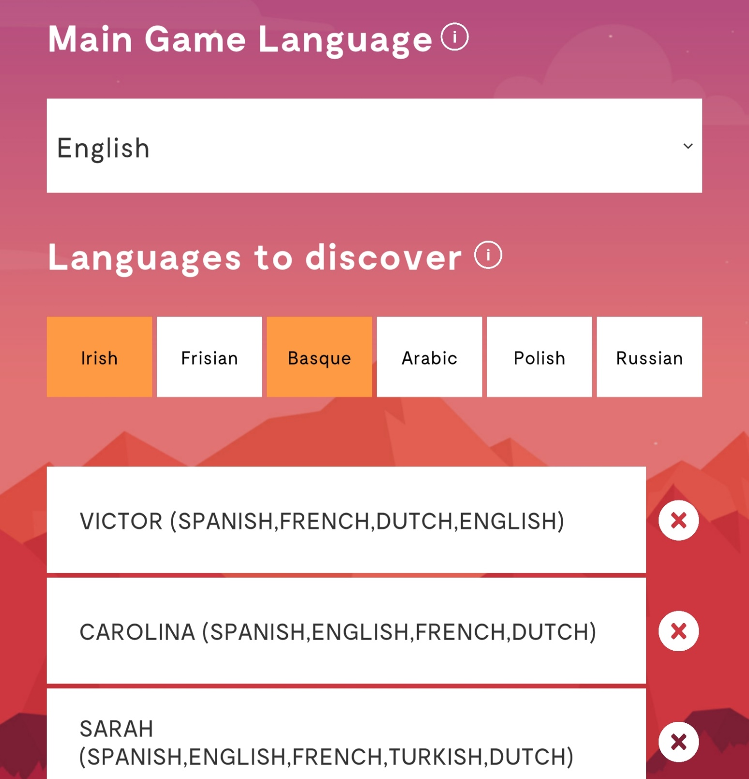
GOALS GAME
Create positive multilingual awareness for teachers in primary schools
Play with multilingualism in classrooms can be fun & augment brain plasticity
Augment self-confidence pupils about languages

Slide 3
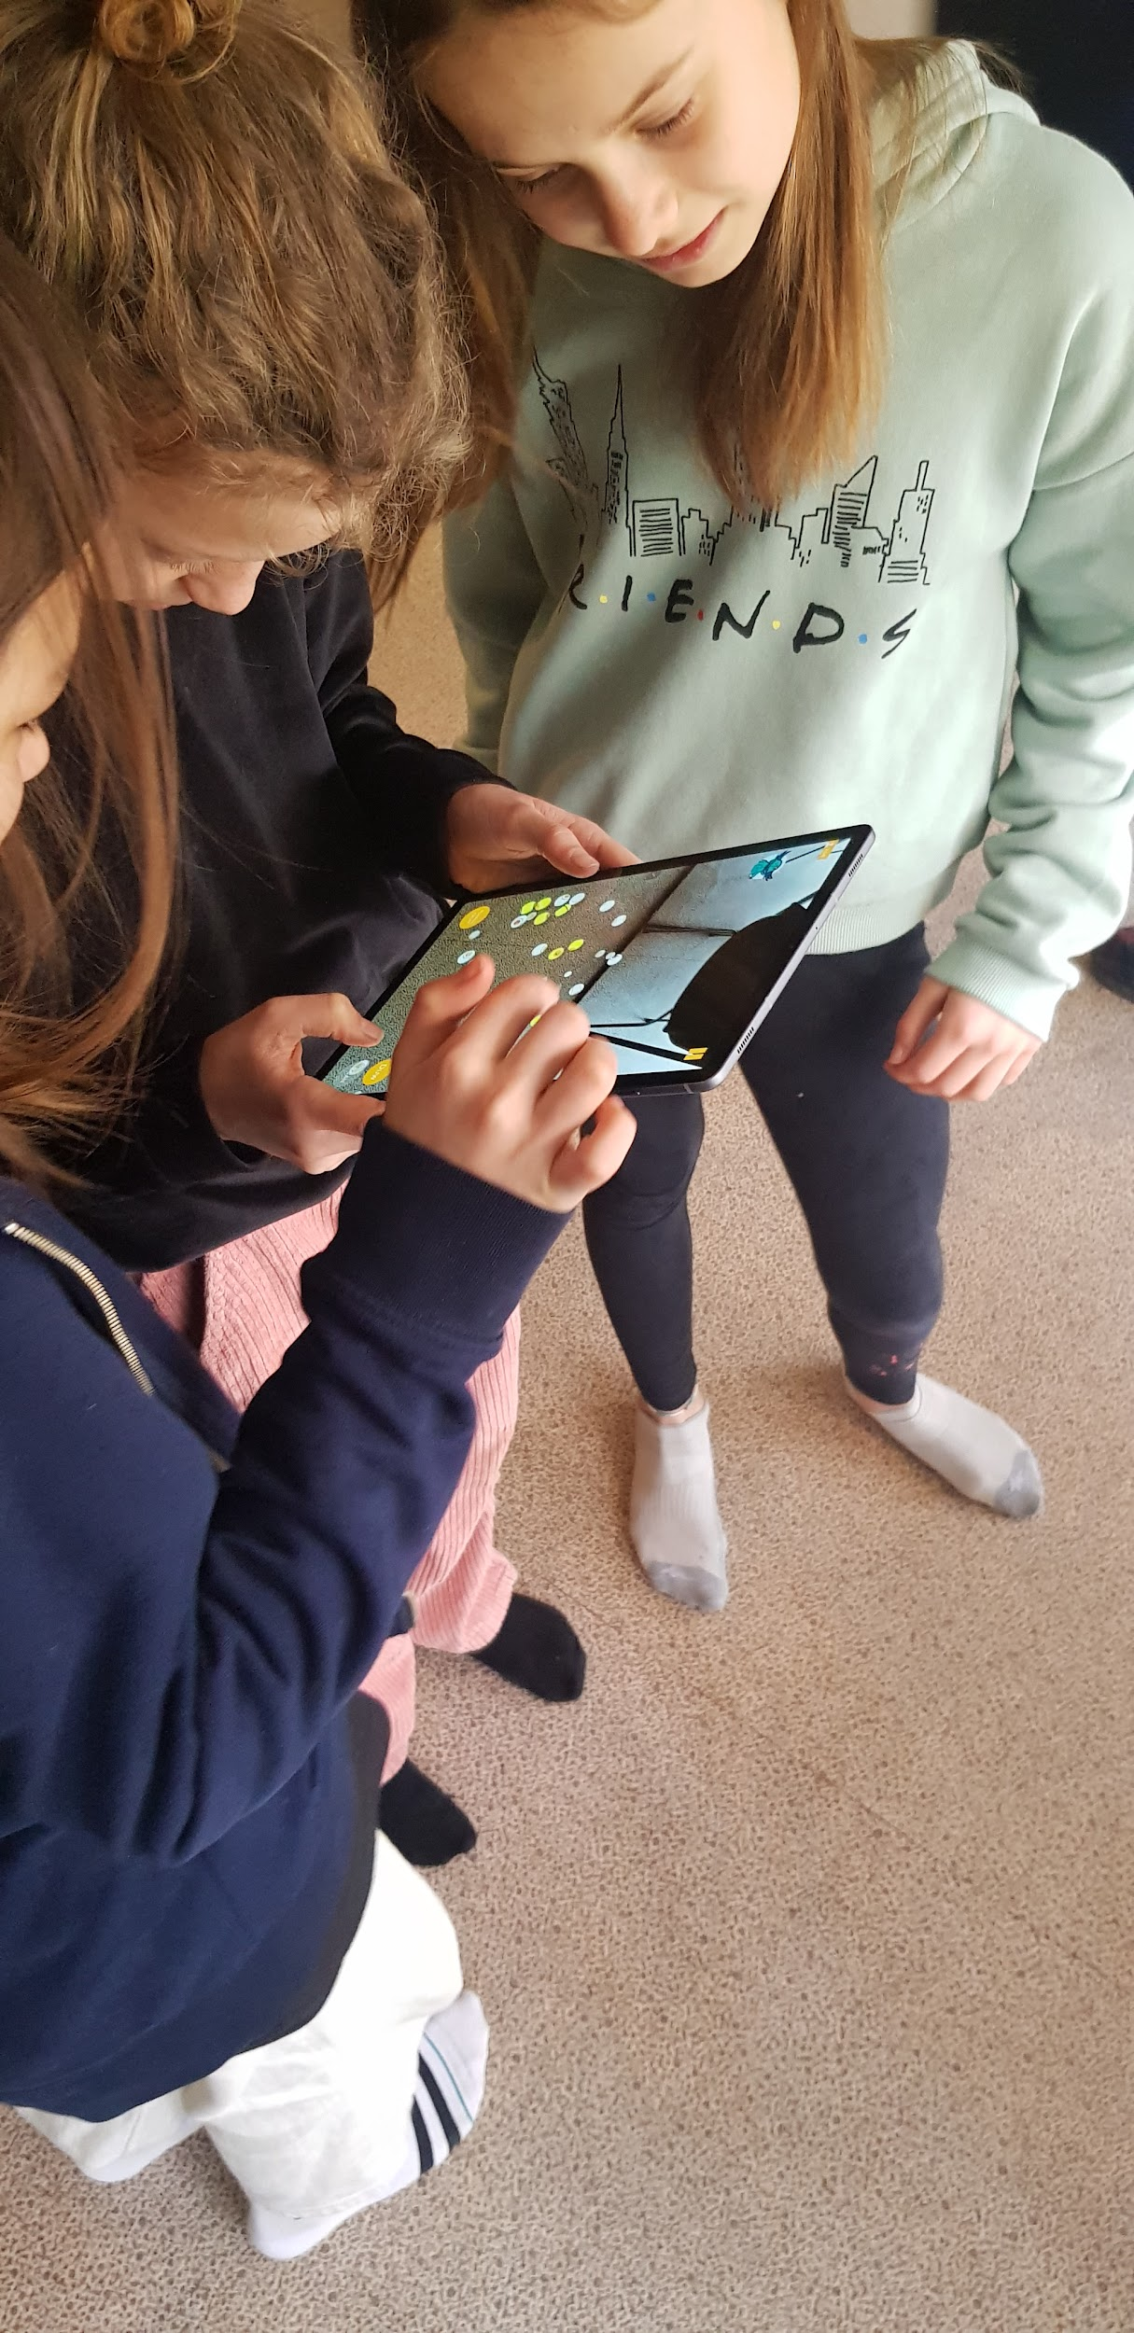


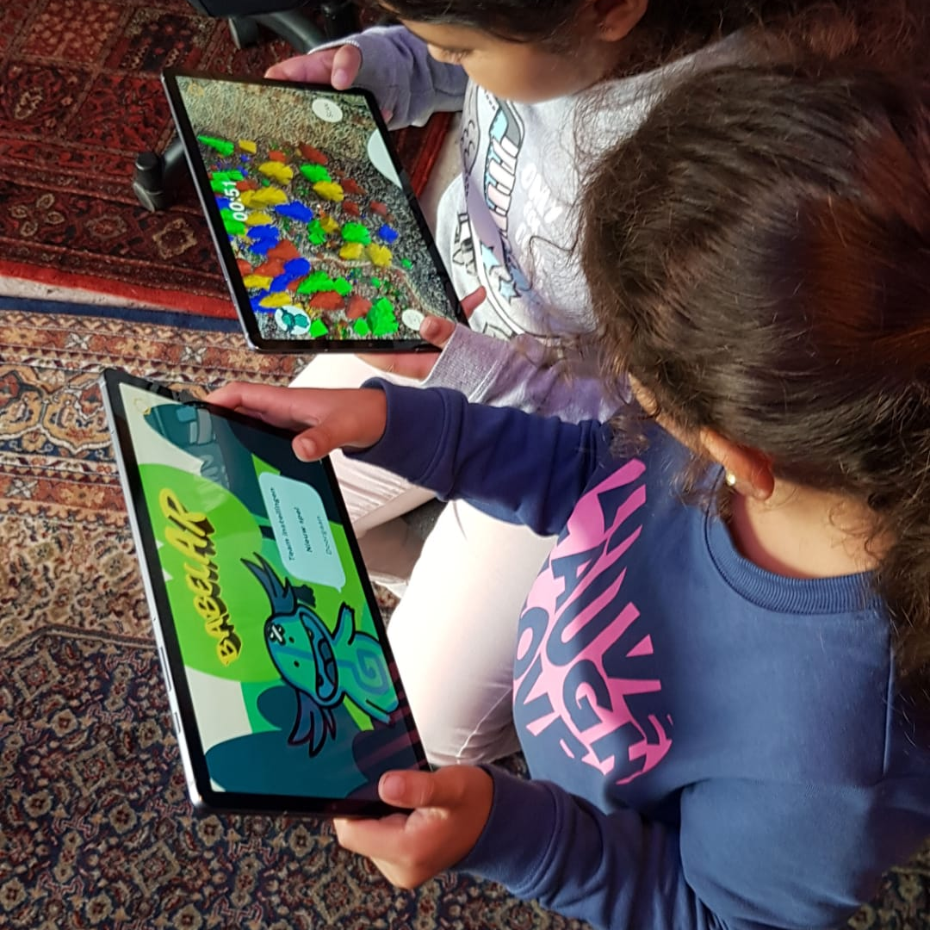

BABELAR
A COLLABORATIVE MULTILINGUAL AR GAME

Slide 4
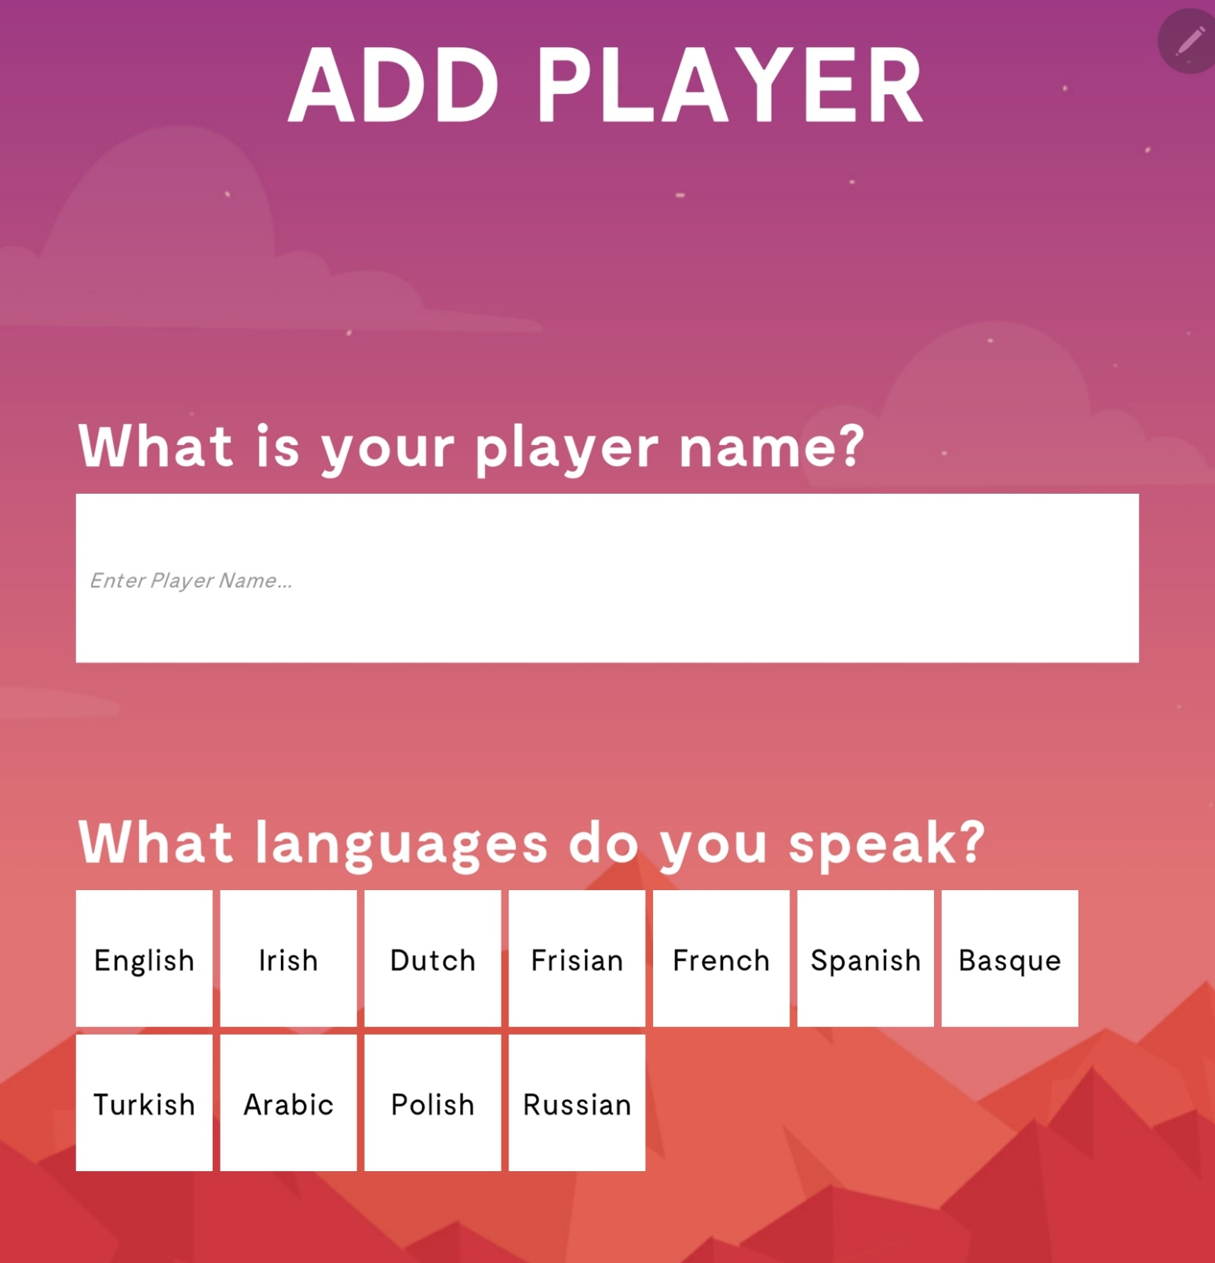
SPECS GAME
15 languages
7 - 12 years (with difficulty levels)
Collaborative – multiplayer(2-6p)
More languages possible!
Android & iOS (Preferred on Tablet)
Where’s Waldo?! in Augmented Reality
Text to speech

Slide 5
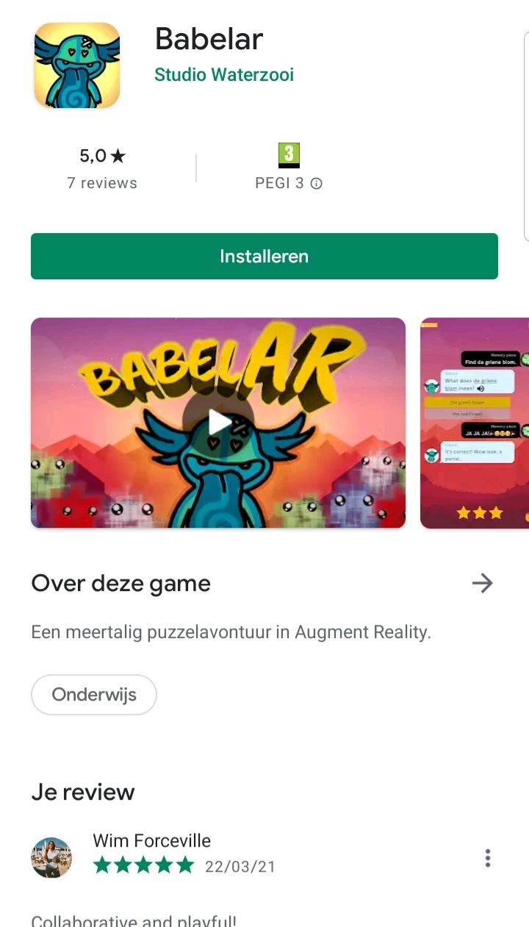
STATUS
NOW: Silent release
SEPT 21 : Full release
Please ask for joining the community
info@virtulapp.eu

Slide 6
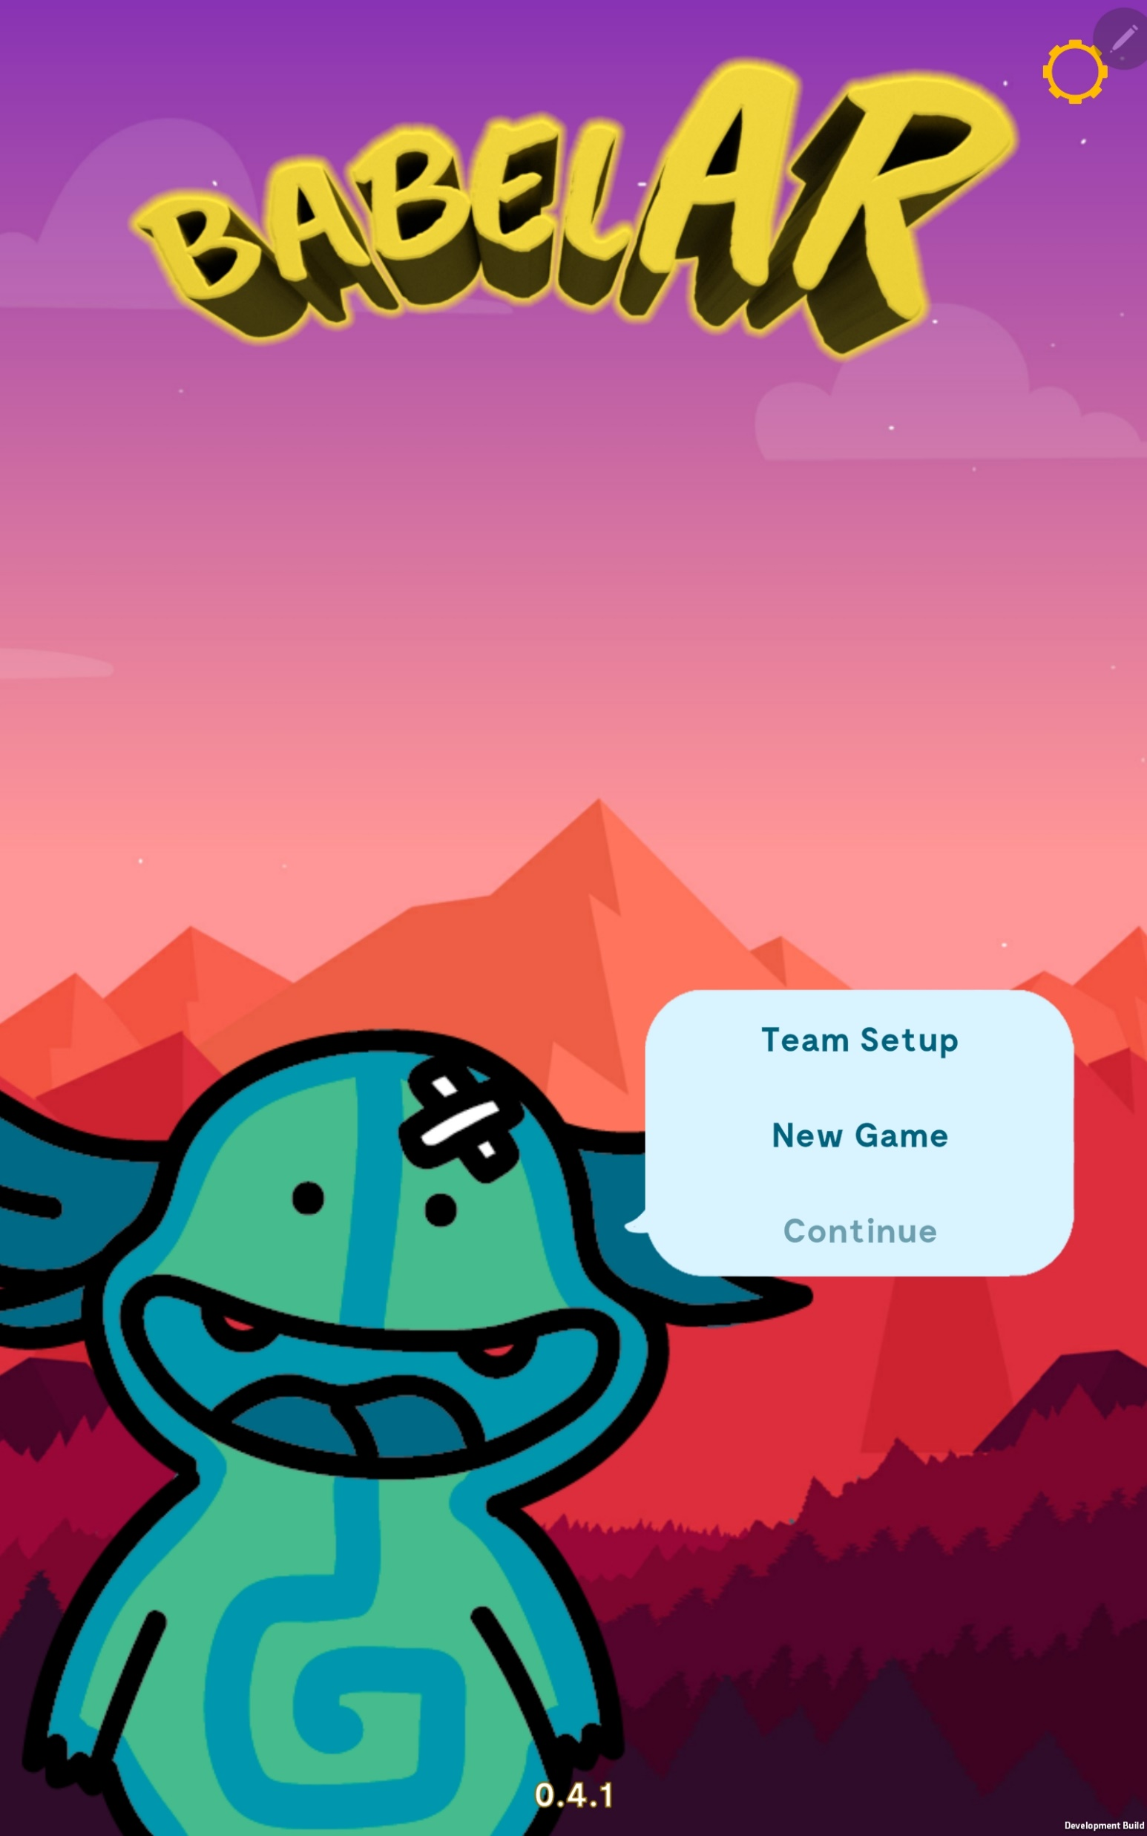
Please feedback
https://virtulapp.eu/game/feedback-babelar/
Follow VIRTULAPP on
FACEBOOK

Slide 7
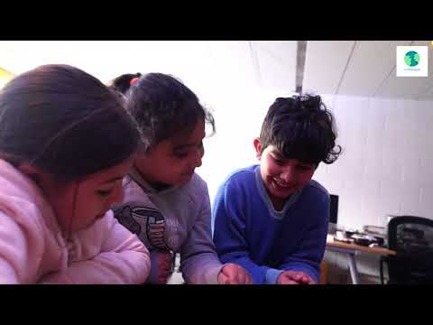

Slide 8
